Slide 1
Lab3 back propagation

Slide 2
Outline
back propagation
Dataset
code

Slide 3
Outline
back propagation
code

Slide 4
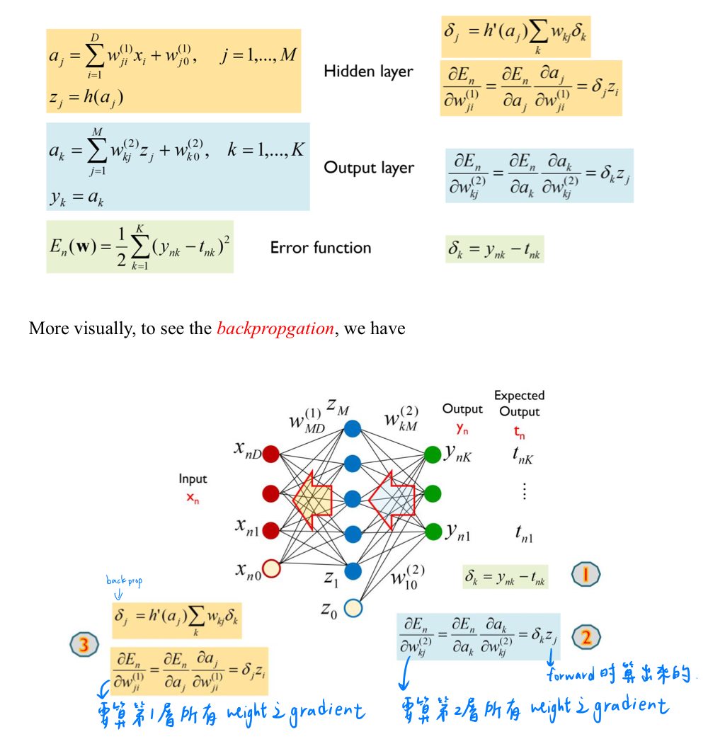
back propagation

Slide 5
Outline
back propagation
dataset
code

Slide 6
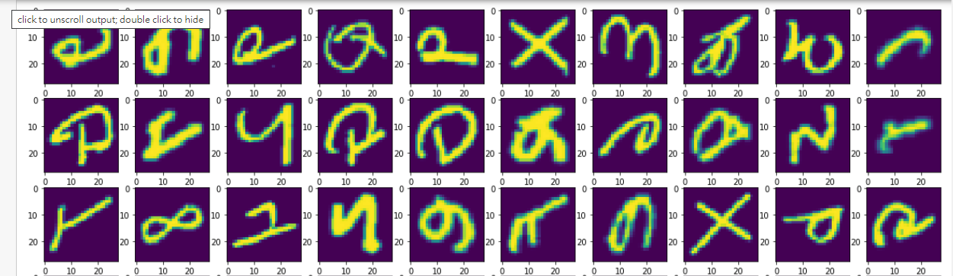
data
Classification , classes: 47, image size =28*28
Training .csv --> first column is label , 1~748 is image value
test_nolabel .csv --> 0~747 is image value
train: 112,800, test: 18,800

Slide 7
Outline
PCA
K-means
Code

Slide 8
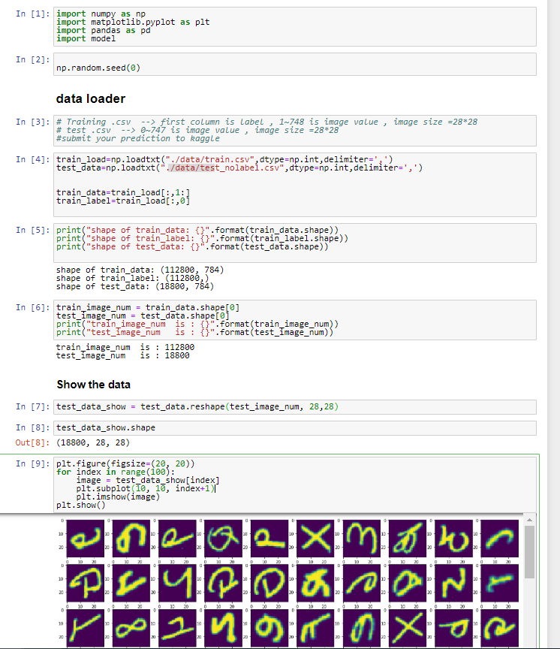
Code

Slide 9
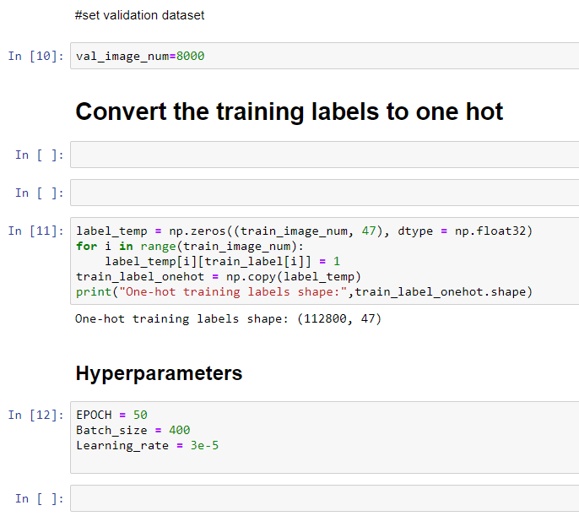
Code

Slide 10
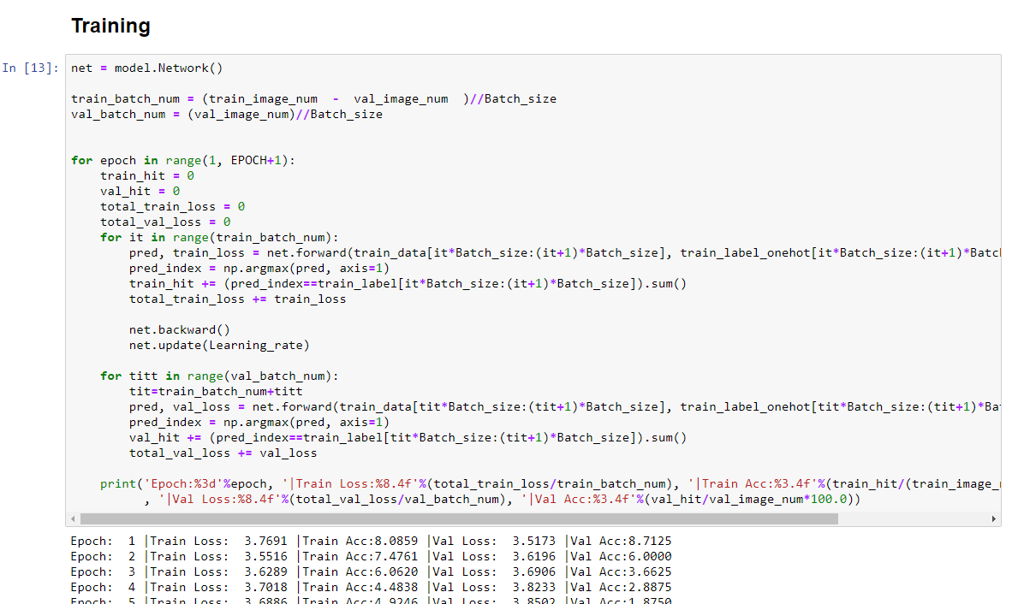
Code

Slide 11
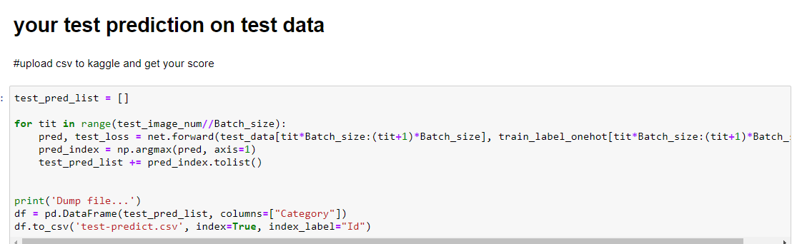
Code

Slide 12
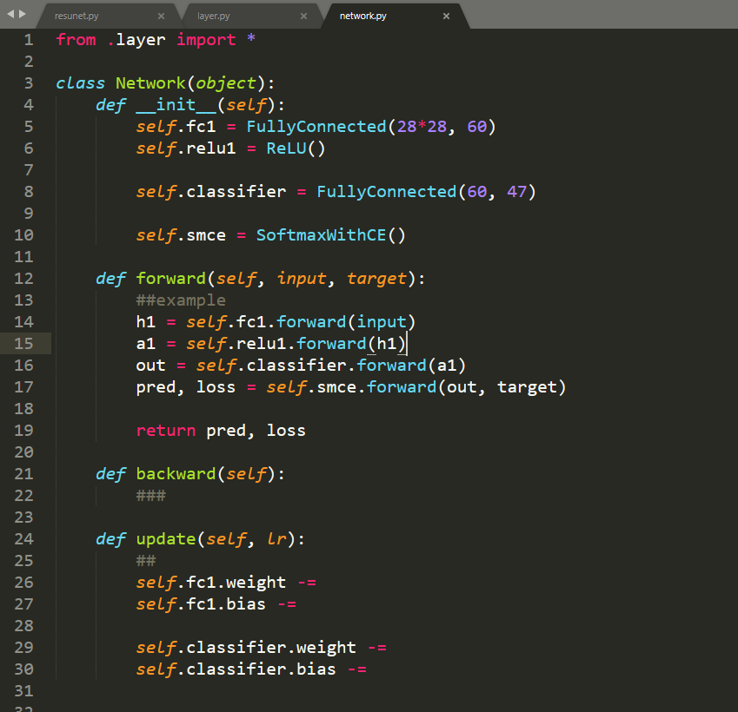
Code

Slide 13
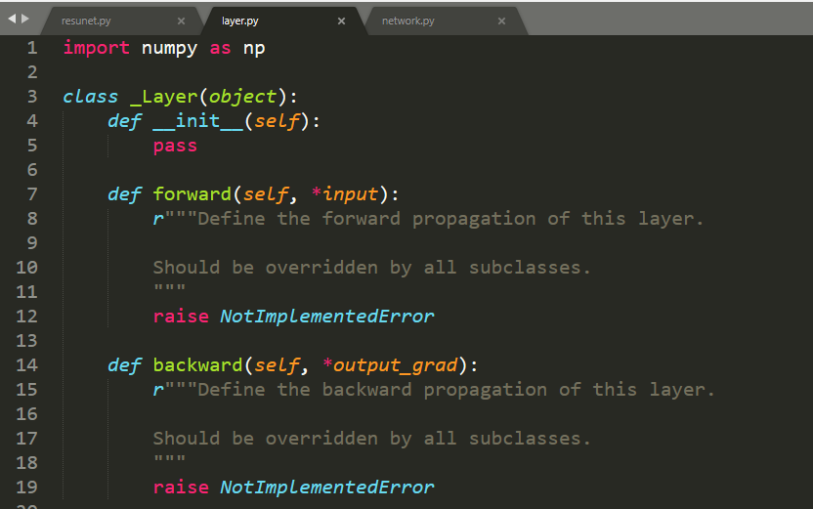
Code

Slide 14
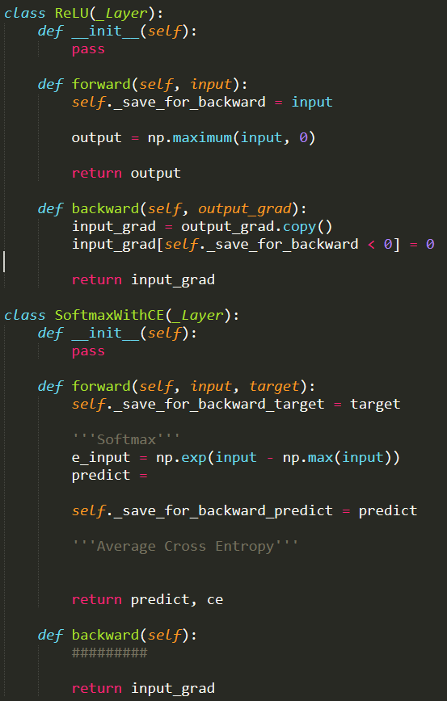
Code

Slide 15
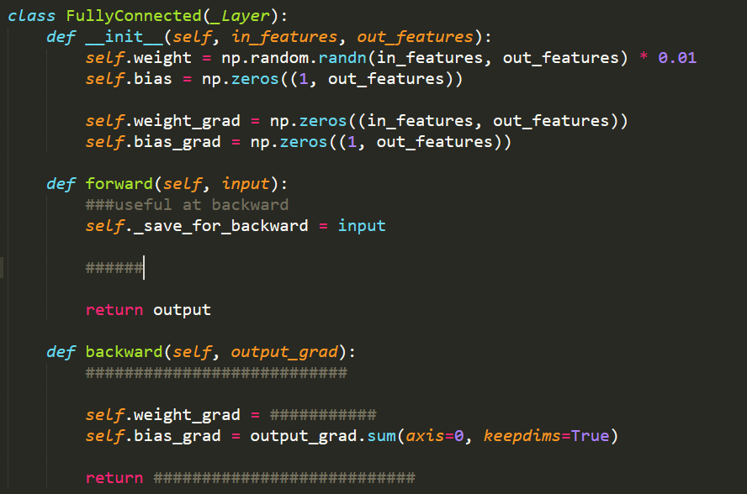
Code

Slide 16
Yourself
Complete layer.py
Complete network.py
Improve your accuracy

Slide 17
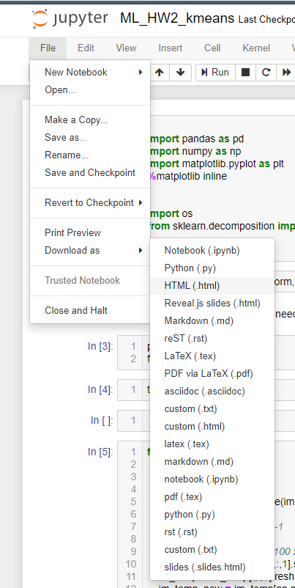
Submit your homework on E3
Download your jupyter as .html
And submit it to E3

Slide 18

Join the Kaggle competition
Competition URL:
https://www.kaggle.com/t/8fc0fb01a3d241fe93ccf8cbb5fa8255
Upload your test prediction
Check your team name

Slide 19
Reminder
Submit Deadline : 2 week (01日/05月/2020 11:59 PM)
You need to submit your code and result to New E3
Hand in your code and in the following format(3 files)
Lab3_studentid.ipynb
Lab3_studentid.html
network.py
layer.py
Lab3_report_studentid.pdf

Slide 20
Lab3 Gading policy
Lab3
Submit your homework to E3 and kaggle(40%),test accuracy must >79%
performance (50%), Convolution will much improve the test accuracy
report(10%)
請勿抄襲 (抓到以0分計算)

Slide 21
Shut down your kernel !!!!!
Remember to SHUTDOWN the kernel
To release resources for others.

